Slide 1
Chapter 4 Paths in Graphs
School of Science, Yanshan University
Wang Gang

Slide 2
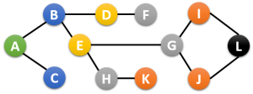
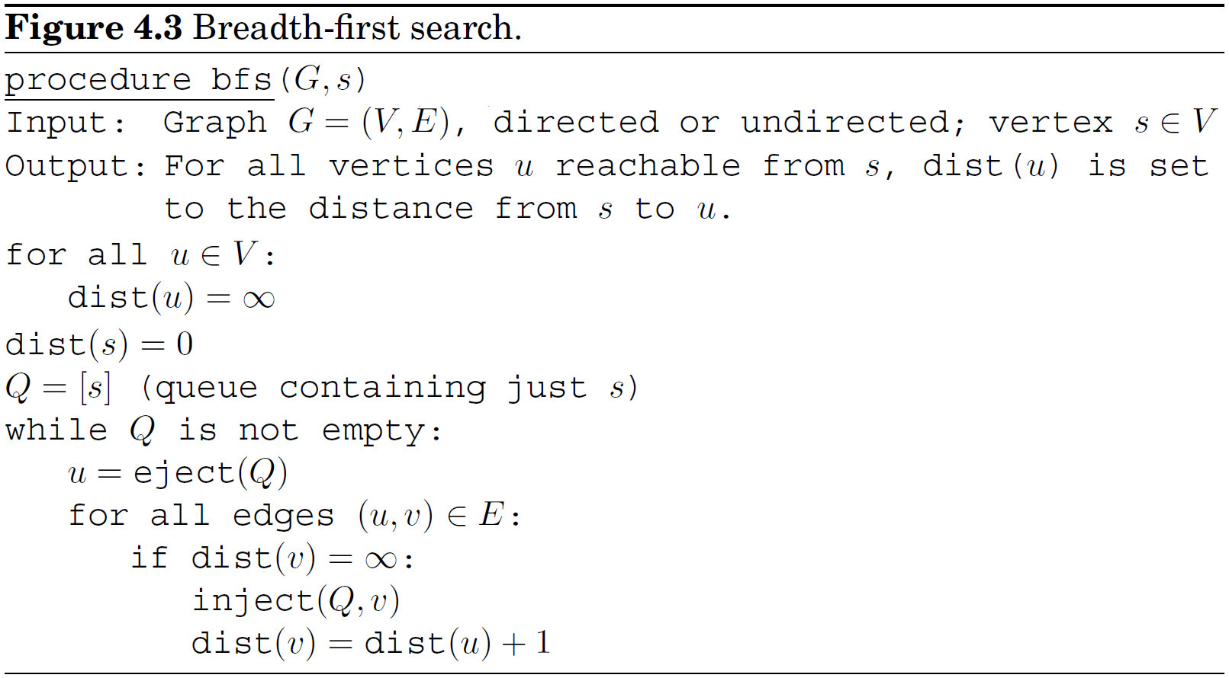
Breadth-First Search
Breadth-First Search: layer by layer,
propagation of a wave upon water

Slide 3
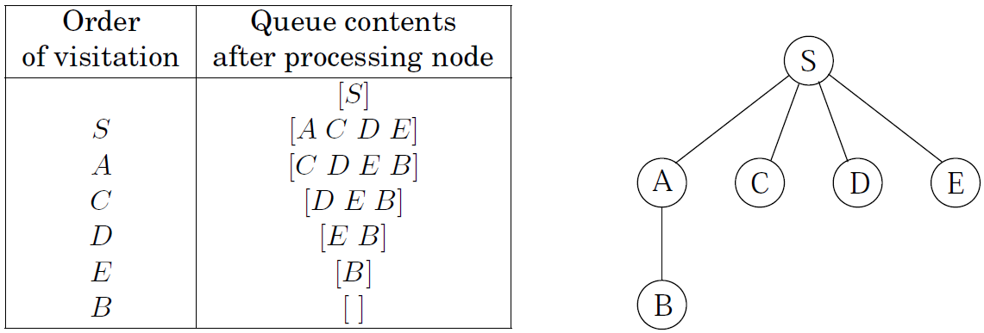
Breadth-First Search
The key data structure is the queue Q.
Correctness: , there is a moment at which
all vertices at distance ≤ d have their distances correctly set;
all other vertices have their distances set to ;
Q contains exactly the nodes at distance d.
Complexity: O(|V|+|E|)
each vertex is put on the queue exactly once. 2|V|
examine each edge once (digraph) or twice (graph). O(|E|)

Slide 4
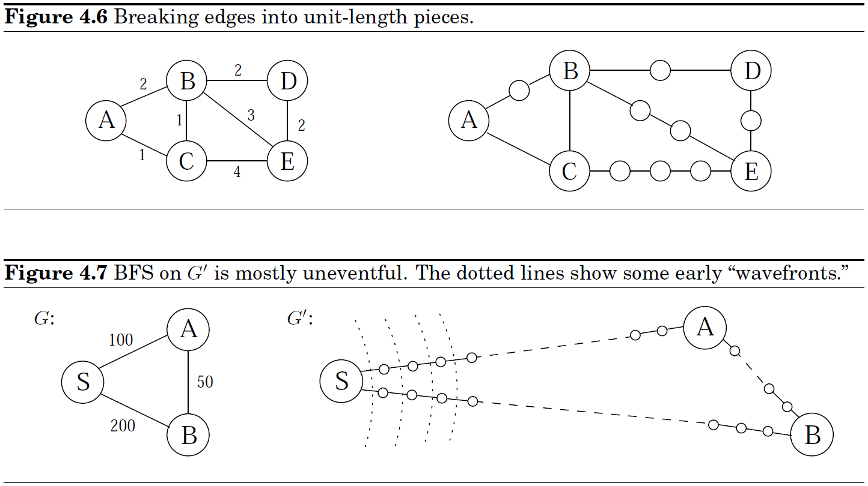
Breadth-First Search
BFS in graphs with non-negative integer edge lengths

Slide 5
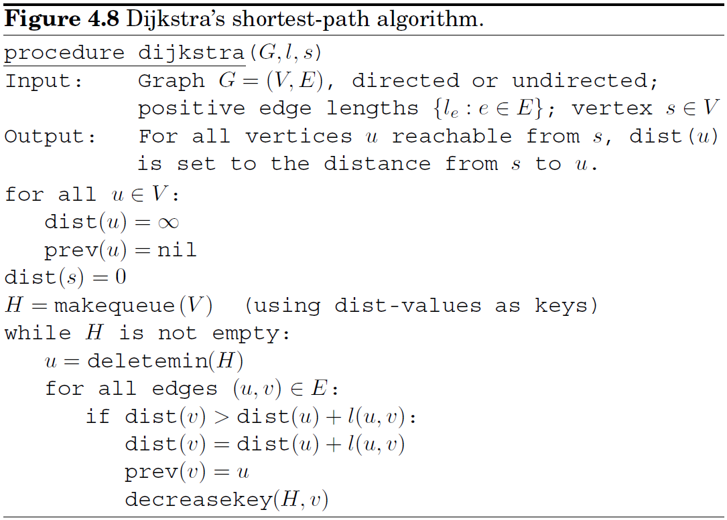
Dijkstra's algorithm
Shortest-path problem in graphs with non-negative edge lengths.

Slide 6
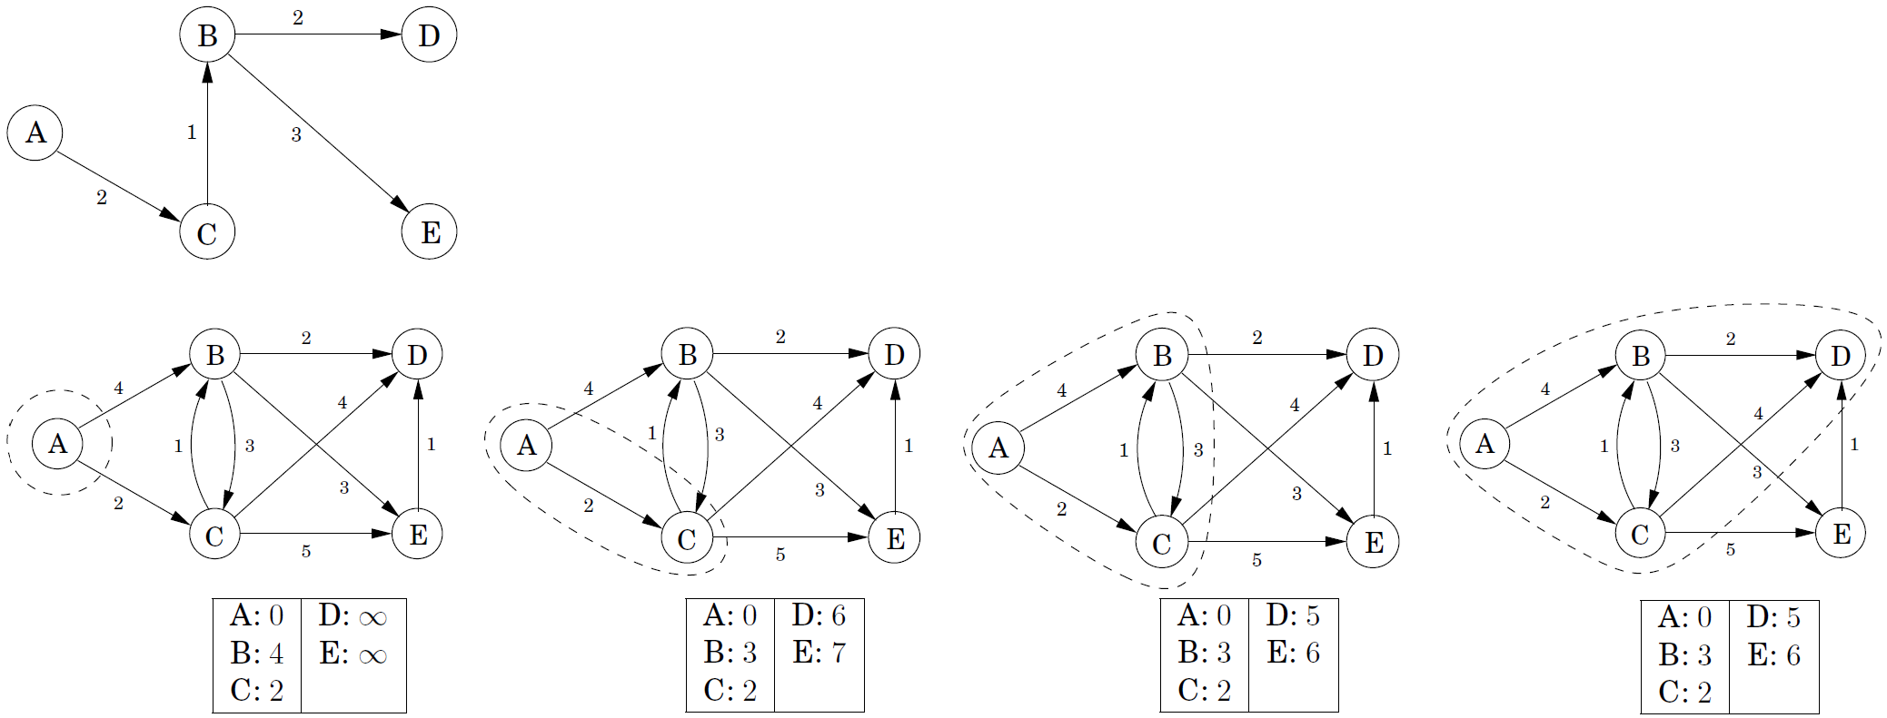
Dijkstra's algorithm
Dijkstra's algorithm is an extension of BFS. It uses a priority queue instead of a regular queue, so as to prioritize nodes in a way that takes edge lengths into account.

Slide 7
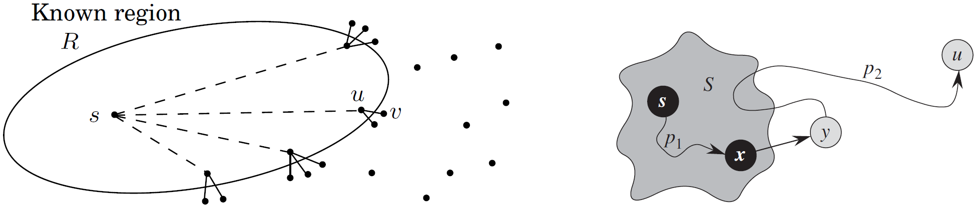
Dijkstra's algorithm
Another perspective: expand outward from the source s, steadily growing the region R to which distances and shortest paths are known. The next addition to it should be the vertex outside R that is closest to s. Let us call it v. How do we identify it?
: the shortest single-edge extensions of the known shortest paths.
Time complexity: depends on the implementation of the priority queue.
|V| insert, |V| deletemin, |E| decreasekey.
If Q is binary heap, O((|V|+|E|)log|V|).

Slide 8
Priority queue implementations
Typical priority queue implementations:
Binary heap: Elements are stored in a complete binary tree.
The key value of any node is less than or equal to that of its children.
insert: place the new element at the bottom of the tree and let it bubble up.
decreasekey: bubble up from its current position.
deletemin: return the root value, move the last node in the tree to the root, then sift down by swapping it with the smaller child and repeat.
Implementation | deletemin | insert/decreasekey | Dijkstra
Array | O(|V|) | O(1) | O(|V|²)
Binary heap | O(log|V|) | O(log|V|) | O((|V|+|E|)log|V|)
d-ary heap
Fibonacci heap | O(log|V|) | O(1) (amortized) | O(|V|log|V|+|E|)

Slide 9
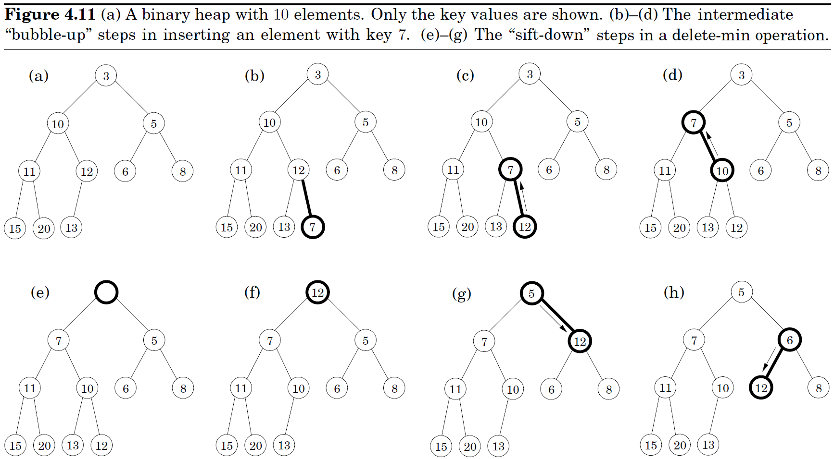
Priority queue implementations
Binary heap: Elements are stored in a complete binary tree.
The key value of any node is less than or equal to that of its children.

Slide 10
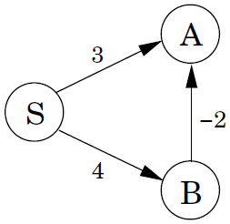
Shortest paths in the presence of negative edges
Invariant of Dijkstra: update dist(v) from down to its correct vale.
procedure update((u,v)∈E)
dist(v) = min{dist(v), dist(u)+l(u,v)}
Two facts about update():
If u is the second-last node in a shortest path to v, and dist(u) is correctly set, then update() gives the correct distance to v.
It will never make dist(v) too small. Any extraneous update() is safe.
update() depends on two facts:
1. A prefix of a shortest path is also a shortest path.
2. The length of a sub-path is less.
Fact 2 dose not hold in the presence of negative edges.
Dijkstra's shortest single-edge extension mechanism fails.

Slide 11
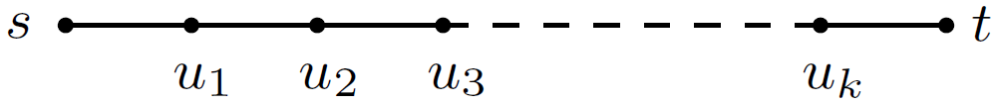
Bellman-Ford algorithm
When there are negative edges, look at a shortest path from s to t:
This path contains at most |V|-1 edges. If a sequence of updates performed
includes (s,u₁), (u₁,u₂), (u₂,u₃),…, (u_{k},t), in that order (not necessarily consecutively), then by property 1, dist(t) will be correctly computed.
It doesn't matter what other updates occur on these edges, or what happens in the rest of the graph, because update()s are safe.
Don't know all the shortest paths beforehand?
Simply update all the edges |V|-1 times!
That is the O(|V|·|E|) Bellman-Ford algorithm.

Slide 12
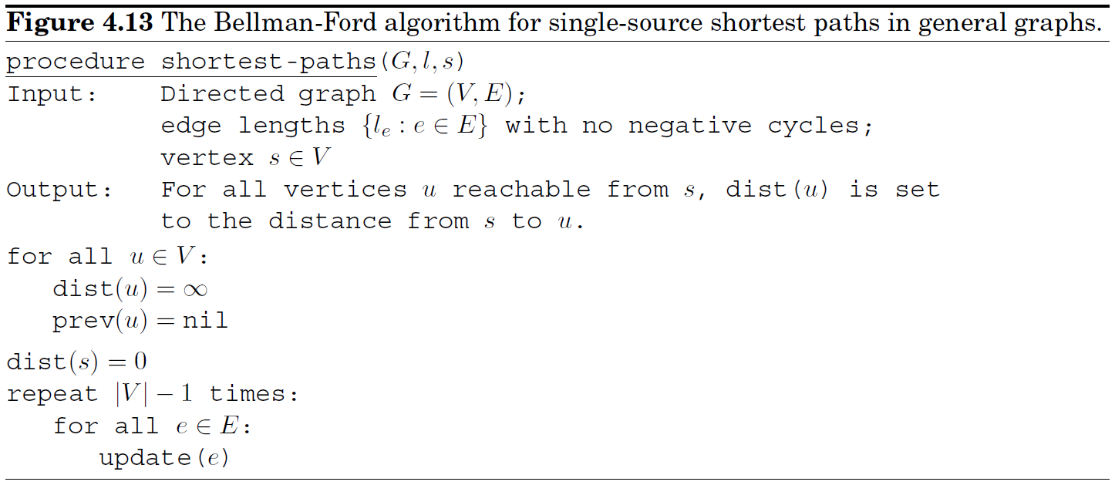
Bellman-Ford algorithm
Sometimes |V|-1 iterations may be too much. When no dist value is reduced during one round, stop!

Slide 13
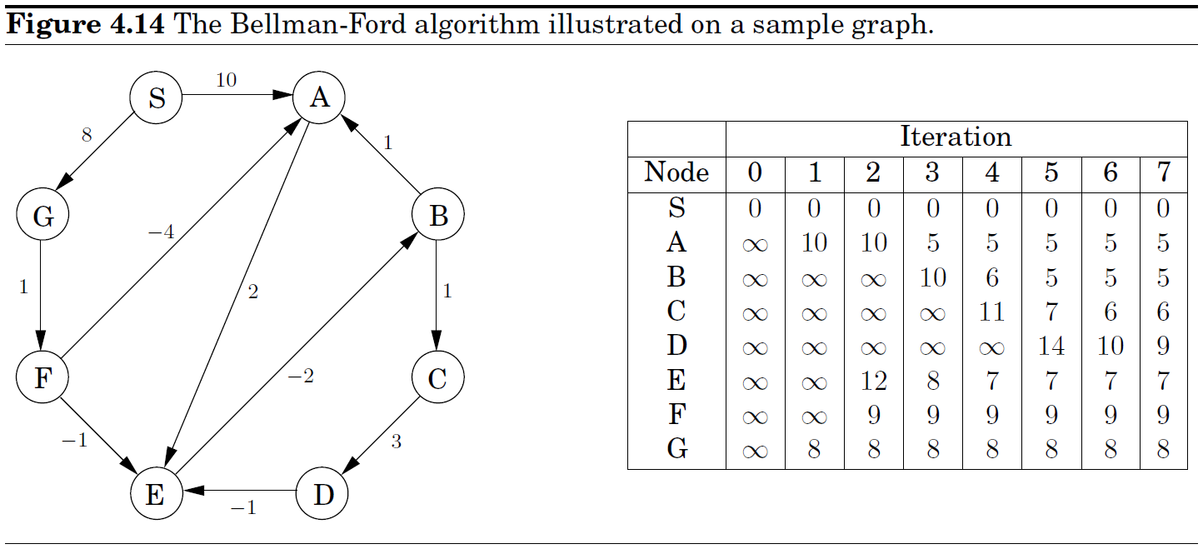
Bellman-Ford algorithm

Slide 14
Bellman-Ford algorithm
Detecting negative cycles: Instead of stopping after |V|-1 iterations, perform one extra round. There is a negative cycle if and only if some dist value is reduced during this final round.
.
dist(u)'+dist(v)'+dist(w)' ≤ dist(u)'+dist(v)'+dist(w)'+(−6+2+3)
dist(w)' ≤ dist(u) − 6
dist(v)' ≤ dist(w) + 2
+ dist(u)' ≤ dist(v) + 3

Slide 15
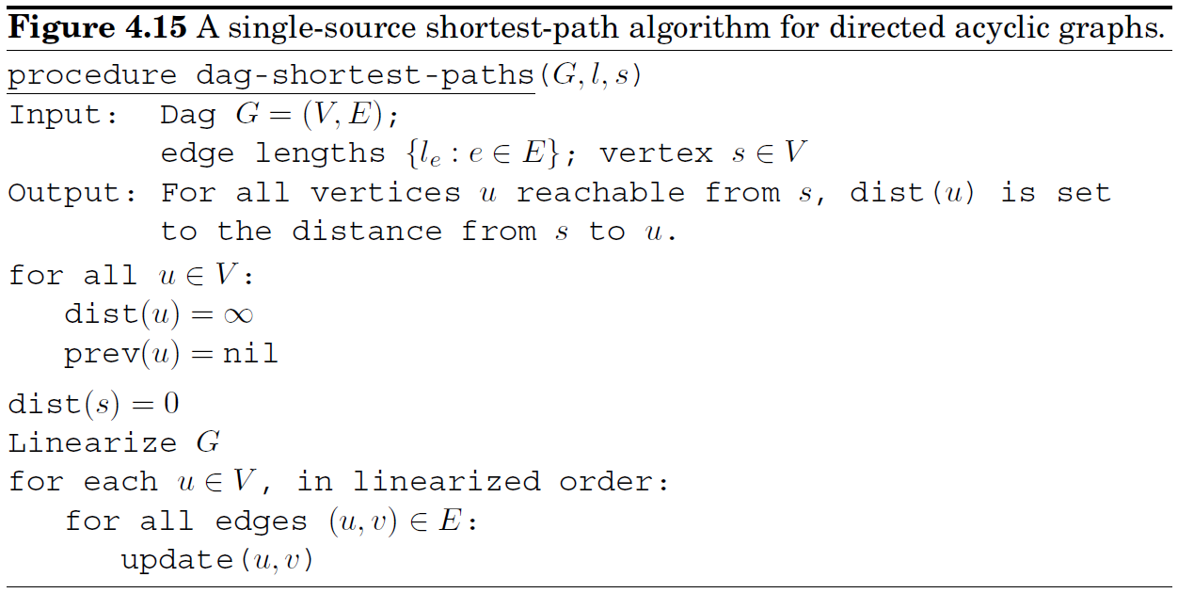
Shortest paths in dags
Two subclasses of graphs contain no negative cycles:
graphs without negative edges;
graphs without cycles.

